Slide 1
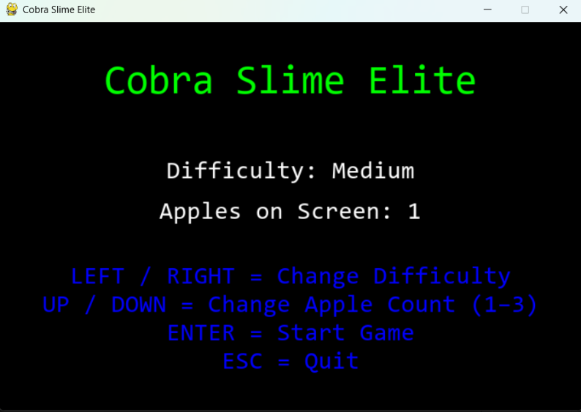
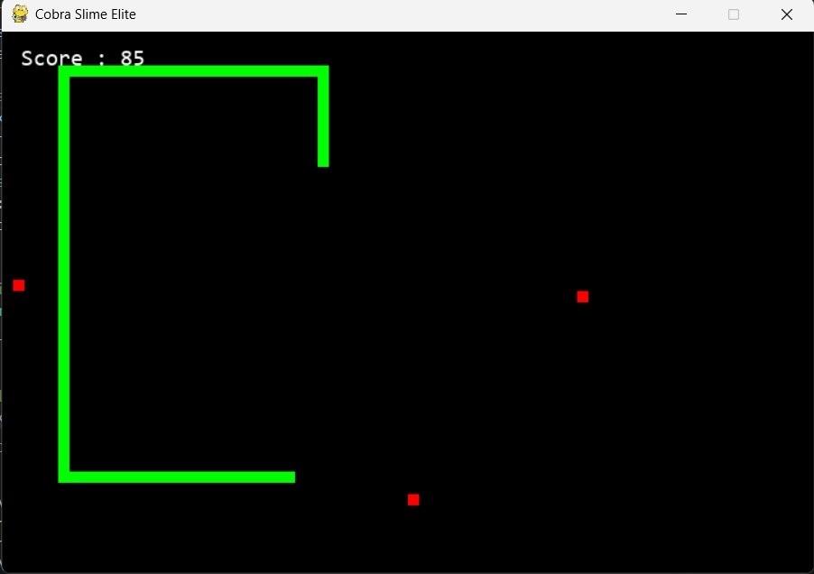
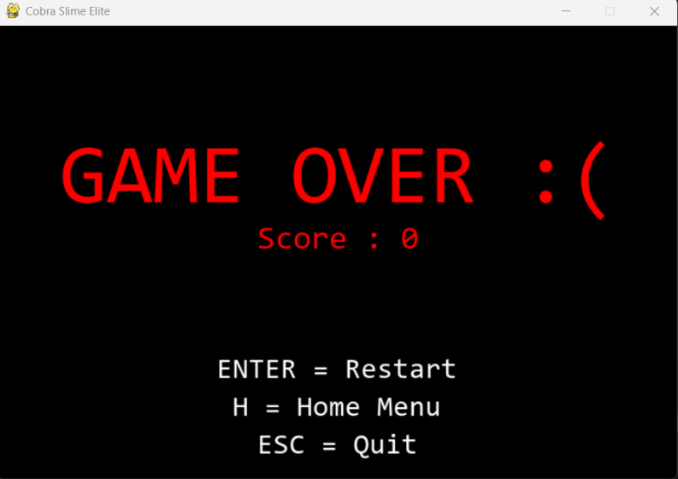
Cobra Slime Elite
Cobra Slime Elite is a game where you dodge, eat, and survive through obstacles. You can change the difficulty and apple amount for a customized challenge every time! Future updates will introduce new game modes and more customization to make the game a unique experience.
A game designed by Donovan Armstrong and Hakeem King

